Slide 1
Empowering Customers: Why Microsoft Loves Linux
Jim Zimmerman
Former Red Hat Alliance Lead
Microsoft Corporation

Slide 2
Our Open Source Strategy
Meet where customers are
Deliver the most productive and trustworthy cloud services platform that enables developers using any framework on any device or OS to create and power the world's apps and services that run anywhere
Best cloud platform for partners to succeed

Slide 3
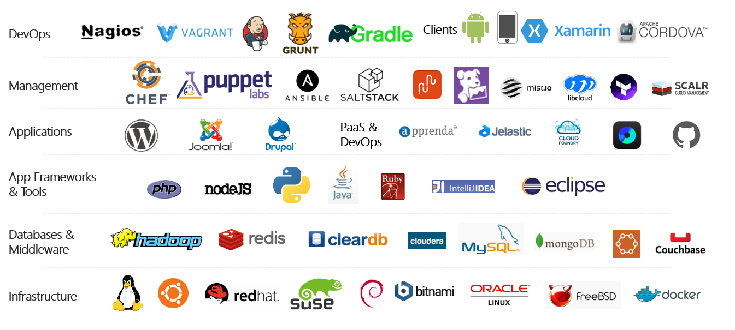
Azure is an open cloud
Notes:
Azure is becoming an open cloud
Several Linux distros supported
Enterprise Linux ( charge an additional $.06 an hour for support )
Red Hat
SUSE
Other Distros
Ubuntu
CoreOS
Debian
CentOS
FreeBSD
Oracle Linux

Slide 4



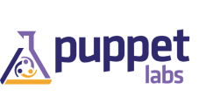
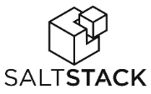







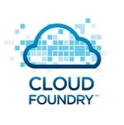





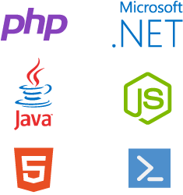
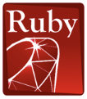


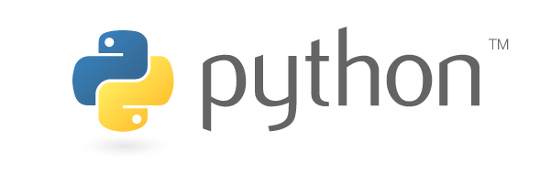




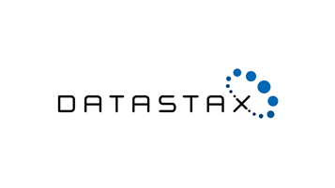

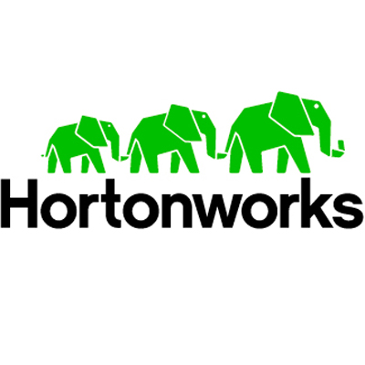
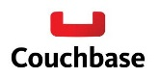

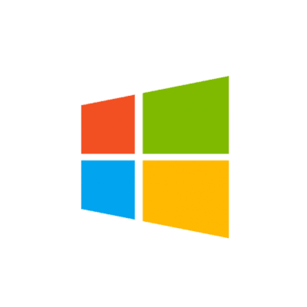







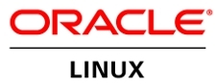
OLD partnership opportunity with Microsoft…..limited to our products
MS Product Centric
Management
System Center
Applications
Dynamics
SharePoint
Exchange
Application Frameworks
.NET
Databases
SQL Server
Infrastructure
Notes:
The reality is that in our industry, open source is pervasive. Just take a look at the technology stack – from the operating system up to the application, there are seemingly countless options in the open source space. Developers love open source, and the majority of those building new cloud based startups are also using open source technologies. Customers leverage it to be disruptive in their vertical, and our competitors are very effective in using it to capture share of wallet in the cloud.
Until now, we have successfully monetized a tight, vertically integrated family of technologies. But if we want a larger share of wallet in the cloud, it’s evident that we need to look beyond our only stack only and monetize open source technologies on Azure. By FY17 OSS is expected to represent an $18B opportunity in the IaaS and PaaS market. A large portion of private cloud and the majority of public cloud today is powered or influenced by open source.

Slide 5

New Era for Microsoft…..with New Partnership Whitespace
Public Cloud
Hybrid Cloud
Private Cloud
Our Cloud Opportunity $$$
Management
System Center
Applications
Dynamics
SharePoint
Exchange
Application Frameworks
.NET
Databases
SQL Server
Infrastructure

Slide 6
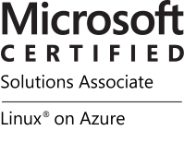
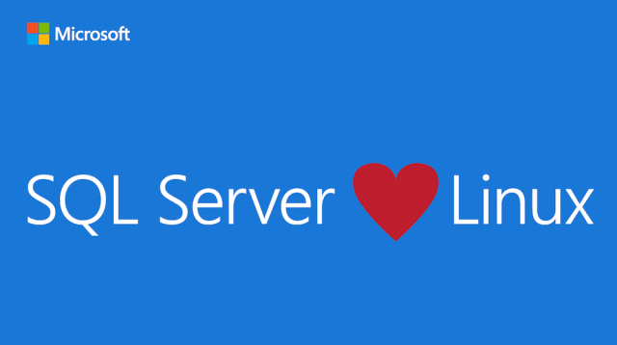
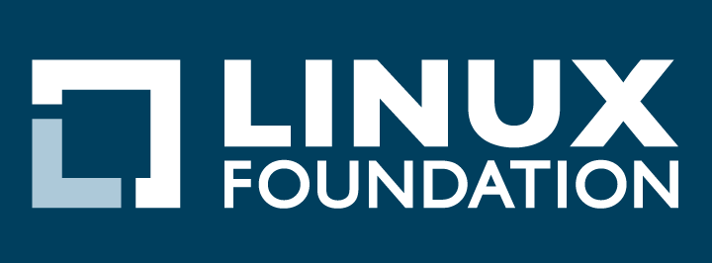


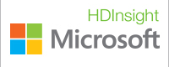


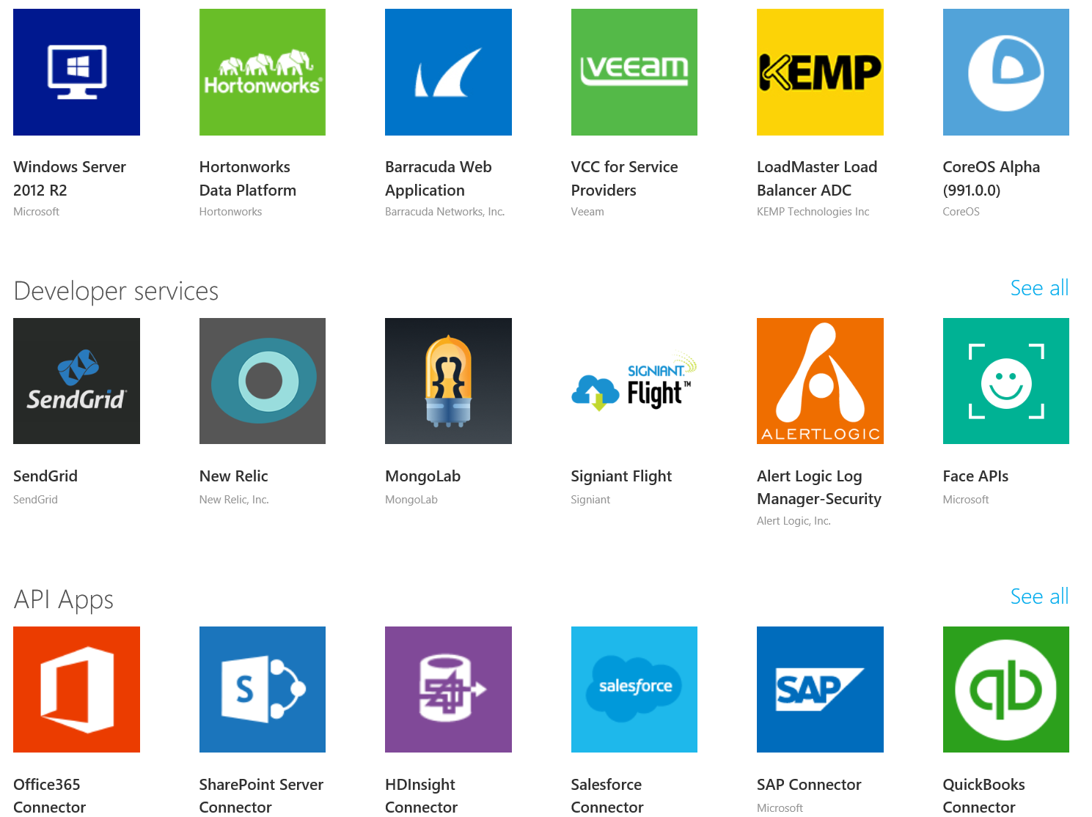
Momentum at Microsoft…
SQL Server on Linux
(Preview today, GA in mid-2017)
In partnership with the Linux Foundation, Microsoft releases the Microsoft Certified Solutions Associate (MCSA) Linux on Azure certification.
Red Hat - Microsoft Partnership
(Nov 2015)
Microsoft Employees
Ross Gardler: President Apache Software Foundation
HD Insight PaaS on Linux GA (Sep 2015)
Microsoft joins Eclipse Foundation. (Eclipse is the largest OSS Dev Toolset)
(Mar 2016).
Azure Marketplace
60% of all images in Azure Marketplace are based on Linux/OSS
Windows Subsystem for Linux
Run Linux on Windows natively
(March 2016)
1 out of 4 VMs on Azure runs Linux, and getting larger every day
28.9% of All VMs are Linux
>50% of new VMs
1 out of 4 3
bash
467,484,471+
Lines Contributed
Open Source Hub

Slide 7


Red Hat and Microsoft Partnership Overview & Opportunity

Slide 8
Why Partner Now?
Customers want…
Support and service for hybrid clouds, spanning heterogeneous technologies and architectures
New generation of application development capabilities from Microsoft and
Red Hat
Flexible, hybrid deployment and technology options
Portability and manageability
Confidence and choice in the enterprise cloud
8
Notes:
8

Slide 9
Strategic partnership between Red Hat and Microsoft
Integrated support services for hybrid clouds, including Red Hat® products in on-premise customer environments and on Microsoft Azure
Microsoft .NET integration and availability with Red Hat Enterprise Linux®, including Atomic Host, and OpenShift by Red Hat
Red Hat products offered and supported on Microsoft Azure
Microsoft Windows supported on Red Hat Enterprise Linux OpenStack® Platform and Red Hat Enterprise Virtualization
Management tooling integration for open hybrid cloud implementations with Red Hat CloudForms
Microsoft joins the Red Hat Certified Cloud and Service Provider program (CCSP)
9
Notes:
There are 5 elements to this unique and deep relationship:
1) Integrated Support, both on and off premise with co-located support engineers to ensure that hybrid cloud customers an receive full support services covering both company's offerings in the hybrid cloud
2) Partnership on .NET for customers and ISVs where Red Hat will be shipping and supporting open sourced .NET with RHEL and OpenShift.
3) Availability and support of Red Hat offerings on Azure as well as extended support for Microsoft Windows on RHEL-OSP and RHEV
4) Integration of Red Hat Management offerings to support Microsoft Azure and System Center.
5) Inclusion of Microsoft as a Red Hat Certified Cloud and Service Provider enabling Azure as a trusted destination for customers to use Red Hat offerings.
9

Slide 10
Delivering the hybrid cloud
Available
Today
Available
Today
Available
Today
Available
Today
Available
Today
Integrated support services for hybrid clouds, including Red Hat® products in on-premises customer environments and on Microsoft Azure
Microsoft .NET integration and availability with Red Hat Enterprise Linux®, including Atomic Host, and OpenShift by Red Hat
Red Hat products offered and supported on Microsoft Azure
Microsoft Windows supported on Red Hat Enterprise Linux OpenStack® Platform and Red Hat Enterprise Virtualization
Management tooling integration for open hybrid cloud implementations with Red Hat CloudForms
Microsoft joins the Red Hat Certified Cloud and Service Provider program (CCSP)
10
Notes:
Within one week of making this market-leading announcement, Red Hat and Microsoft delivered on 3 of the 5 major elements.
As we look to the future, we are committed to supporting enterprise customers and ISVs as we make the migration to the enterprise cloud.
10

Slide 11


Enterprise Operating System
Guidance
Look for | Pent-up demand from customers who have been waiting for Azure support Customers who need enterprise-grade support for Linux workloads in a public cloud Microsoft and Azure enterprise customers using other, often-unsupported Linux distributions
Win by | Highlighting the value of Red Hat Enterprise Linux in Azure: Joint, Integrated Enterprise-grade support Consistent hybrid cloud management (CloudForms) Flexible consumption (On-demand & BYOS) Secure, stable & modern platform for hybrid clouds Cost savings from consistency and standardization
Don’t | Don’t forget to discuss the value of the entire Red Hat and Microsoft portfolio from Infrastructure through Application Frameworks Don’t focus on zero-sum use cases like Lift and Shift Don’t forget that our partnership will grow and evolve over time to include even more value for enterprise customers
Red Hat Enterprise Linux is the trusted, open source operating system that enterprise customers across the globe rely on to run their business-critical workloads.
Subscription flexibility with Red Hat Cloud Access
Marketplace Images on-demand
Foundation for next-gen architectures
Notes:
Both Red Hat and Microsoft customers have been asking for the availability of RHEL in Azure for some time now. Now our joint customers can choose how they want to deploy RHEL - migrate existing RHEL subscriptions to Azure (BYOS) via the Red Hat Cloud Access program, or leverage the flexibility of RHEL on-demand via the Azure Marketplace. Either way, customers can be sure that they are backed by enterprise-grade support from Red Hat and Microsoft.
Enterprise Hybrid Cloud infrastructures are built using common platforms, standards, and tools that work well on-premise and in the cloud. Red Hat Enterprise Linux is a trusted, open source operating system that enterprise customers across the globe rely on to run their business-critical Linux workloads.
Customers who rely on RHEL in their datacenters today, can now run the same trusted operating system in Azure with a choice of deployment models that best meets their needs.
Extend datacenter capacity with Bring-Your-Own-Subscriptions (BYOS) to Azure via the Red Hat Cloud Access program while maintaining existing support relationship directly with Red Hat
Utility computing via on-demand images in the Azure Marketplace with pay-as-you-go pricing
Modern Linux operating system designed as the foundation for the latest technology trends such as microservices and containers
All enterprise Linux workloads in a trusted public cloud

Slide 12






Hybrid Cloud Management
Guidance
Look for | Customers with hybrid and multi-cloud infrastructures that lack consistent management tools Customers wanting a single tool for managing Windows and Linux workloads across their hybrid cloud Red Hat customers who want advanced visibility and control of container and OpenShift environments
Win by | Highlighting the value of Red Hat CloudForms in Azure: Azure ARM support Integration with System Center VMM provides lifecycle management both on-premise and in Azure Ability to manage other Red Hat solutions in Azure such as OpenShift Advanced hybrid cloud workload placement and SmartState analysis capabilities (coming soon)
Don’t | Don’t focus on “vs.”, instead emphasize how CloudForms integrates, extends, and enhances existing System Center environments Don’t forget that Azure will be the first public cloud environment featuring advanced SmartState analysis capabilities (v4.1) from Red Hat CloudForms Don’t forget about workloads, CloudForms manages infrastructure, apps, and workloads e.g. SQL, AD, etc.
Red Hat CloudForms is a cloud management platform that offers the control and automation capabilities IT staff need to effectively manage increasingly complex hybrid infrastructures.
Hybrid Cloud Management Platform
Intelligent Hybrid Cloud Brokering with Azure
System Center Integration
Notes:
Managing a complex, hybrid IT environment can require multiple management tools, and extra staff to handle operations.
Red Hat CloudForms is a unified management platform for hybrid cloud environments that offers the control and automation capabilities IT staff need to effectively manage increasingly complex hybrid infrastructures. Red Hat CloudForms can discover, control, and manage private and public cloud infrastructures made up of scale-up enterprise virtualization platforms, scale-out OpenStack cloud infrastructures, and public clouds including Azure. Today, existing customers can extend management into Azure and integrate CloudForms with their existing management tools to create a truly unified Hybrid Cloud management platform.
In the future, CloudForms 4.1 will introduce expanded Hybrid Cloud management capabilities for Azure that will include Smart State analysis making Azure the only public cloud with this capability.
Bring existing subscriptions to Azure via the Red Hat Cloud Access program while maintaining existing support relationship directly with Red Hat
CloudForms 4.0 expands its managed platform support to include Azure (ARM) providing core lifecycle management capabilities for those workloads
Self-service provisioning of Azure resources
Intelligent cloud brokering to control VM placement
Unified management with Microsoft System Center VMM & Operations Manager integration
(Future) CloudForms 4.1 with expanded Hybrid Cloud management capabilities for Azure including Smart State analysis

Slide 13

Hybrid Storage
Guidance
Look for | Customers searching for an open, scalable, software-defined storage solution for hybrid cloud environments Customers who need a POSIX compatible solution to ease migration of Linux workloads to Azure while avoiding costly rewrites Target use cases include: Machine Analytics (Splunk), Big Data (Hadoop), Media Streaming, Enterprise File Sharing, Data Archival, Geo-replication for DR
Win by | Highlighting the value of Red Hat Gluster Storage in Azure: Simple to install and configure with a minimal footprint Leverages Azure Availability Sets for data availability during planned or unplanned outages Asynchronous, multi-region data replication with support for on-premise to Azure hybrid use cases Advanced features built-in: Snapshots, Quotas, Erasure Coding, and Intelligent Tiering
Don’t | Don’t ignore opportunities to challenge customer’s perception of lock in to other public clouds on storage and data Don’t underestimate the value of POSIX compatibility for Linux applications in Azure Don’t forget that unstructured data is the fastest growing type of data in the enterprise today
Red Hat Gluster Storage is the reliable and cost-effective, storage solution that’s engineered for Hybrid Cloud environments to deliver rich functionality without rigid hardware dependencies.
Scale-out & Scale-up cloud storage in Azure
Rich Media & Archival
File sync & share
Notes:
Companies today rely on data now more than ever before. Data is a key enabler for business innovation delivered through technologies such as business analytics, data mining, and content delivery.
Red Hat Gluster Storage offers a scale­-out, POSIX compatible, massively scalable, elastic file storage solution in Azure which can be used for multiple use ­cases including archival, rich media streaming, big data analytics, and geo­-replication for disaster recovery. Red Hat Gluster Storage on Azure enables customers to deploy consistent storage technology on-premise and in Azure allowing existing applications to be migrated to cloud more easily. Traditional hardware storage solutions do not offer this level of flexibility – open, software-defined storage can provide the level of compatibility and agility required for hybrid cloud infrastructures.
Red Hat Gluster Storage solutions in Azure provide a foundation for customers to build cloud-ready business services such as Big Data, Analytics, Rich Media, Data Sync & Share, Cloud Infrastructure, Virtual Machine Storage, and much more.
Bring existing subscriptions to Azure via the Red Hat Cloud Access program while maintaining existing support relationship directly with Red Hat
Build reliable, scale-out cloud storage clusters (2TB to 800TB) that can be shared between multiple applications
Easily migrate existing data and applications from on-premise to Azure with built-in POSIX compatibility
Native client support as well as NFS in the first release, existing applications that rely on file interfaces while moving to the public cloud will benefit the most by avoiding expensive rewrites.
Create disaster recovery environments for on-premise applications and data using asynchronous geo-replication capabilities
Supports Linux and Windows operating systems

Slide 14


Hybrid Application Framework
Guidance
Look for | Customers wanting an open PaaS solution that includes next-gen features like Docker containers, Kubernetes orchestration, and supports enterprise CI/CD workflows Java users looking for a consistent platform to run their business applications in Azure Customers building microservices architectures in the public cloud Customers using the hybrid cloud to develop business applications faster and accelerate time to market
Win by | Talking to developers about the value of a common platform for building, deploying, and managing apps across hybrid cloud environments Promoting the integration of Azure services and .NET within OpenShift and RHEL enabling delivery of business value to existing and next-gen applications Understanding the shift from monolithic application models to more agile, scalable, and resilient microservices
Don’t | Don’t limit discussions to just .NET applications on Windows or Java on Linux – both platforms are fully supported on Azure Don’t forget to discuss the concepts and value of Agile software development – standardize, automate, continuous improvement Don’t forget that customers can use Red Hat CloudForms to manage OpenShift container environments in Azure
OpenShift by Red Hat and Red Hat JBoss Middleware enable developers to build, integrate, and deploy cloud-native applications and open Red Hat’s award-winning application middleware, development & deployment solutions in Azure.
Built on an Enterprise Grade Platform
Comprehensive suite of application services
Natively integrated Docker containers
Notes:
The ability to build and run OpenShift Enterprise PaaS environments on Azure offers choice, flexibility, and standardization. Customers will be able to choose Microsoft Windows for Windows containers, and Red Hat Enterprise Linux Atomic Host and OpenShift for certified Red Hat Enterprise Linux containers unified by the common .NET framework.
Collaboration on .NET will enable a new generation of application development capabilities. Developers will have access to .NET technologies across Red Hat offerings, including Red Hat OpenShift and Red Hat Enterprise Linux. With a host of .NET applications already deployed throughout enterprises, customers want the ability to to build .NET applications on infrastructure powered by RHEL.
Red Hat JBoss Middleware is the ideal middleware portfolio for open hybrid cloud environments. JBoss solutions allow customers to accelerate application development, deployment, and performance, integrate data and applications efficiently, and automate business processes across physical, virtual, mobile, and cloud environments. JBoss Enterprise Application Platform (EAP) is the foundational component for the JBoss middleware family. It’s flexibility allows deployment to physical, virtual, and cloud environments. JBoss Enterprise Web Server (EWS) removes the complexity from managing open source-based web application environments by including all of the popular open source technologies - Apache Web Server, Apache Tomcat, and common connectors - for building, deploying, and maintaining web applications and large-scale websites.
Our integrated solutions are designed to meet the current and future needs of enterprise customers with features that allow developers to focus on building the best possible applications and leave the management and orchestration of the infrastructure to the system. OpenShift is designed for the future - as modern applications continue the shift to microservices architectures, the infrastructures that host them must be able to flexible and scalable enough to efficiently run and manage the increasingly complex system of interconnected and distributed application containers.

Slide 15




Integrated Support
Red Hat and Microsoft have created an industry-changing integrated support model for customers using Red Hat solutions in Azure. We are working side-by-side to solve common problems and to provide the enterprise-grade support that customers rely on in their datacenters.
Highlights:
Red Hat participation in Azure forums
Red Hat & Microsoft security response team collaboration
Support staff from Red Hat & Microsoft co-located @Redmond
Integrated ticketing systems
Red Hat Technical Account Management & Microsoft Premier Services

Slide 16
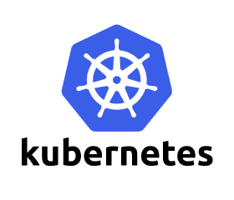
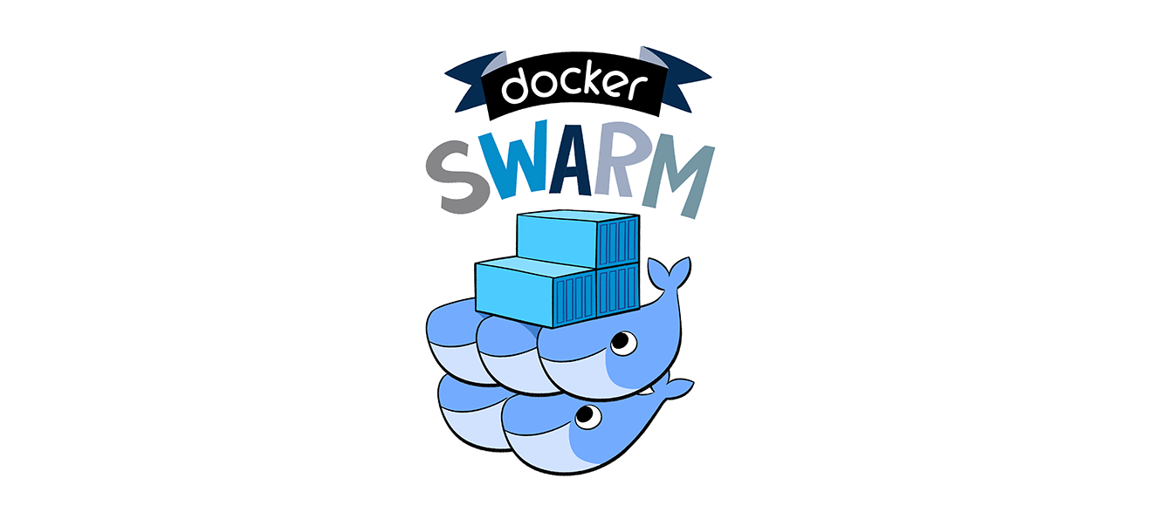

Container Solutions in Azure
Solutions that run on Linux in Azure
Platforms:
Red Hat OpenShift
Kubernetes
Docker Datacenter
Swarm -
Deis
Kubernetes – Open Source Heroku
DC / OS
Mesos – Mesosphere Enterprise Offering
ACS
Mesos, Swarm, and Kubernetes coming soon!
Orchestrators Now Supported in Azure

